Slide 1
PYTHON FOR DATA · 40 MIN
Time Series and Case Studies
Dates, resampling, windows and real-world cases · Unit 4
Dates
Resample
Windows
Cases
Parse and index
Change frequency
Compare with the past
Sales, traffic, risk
to_datetime
resample asfreq
rolling shift
plot groupby

Slide 2
The Time Series Toolkit
~2 min
Dates first, then resample and roll.
1
Dates
2
Select
Parse text and build date ranges.
Slice by date and set a frequency.
to_datetime date_range
ts["2026-02"] asfreq
3
Resample
4
Case studies
Change frequency, shift and smooth.
Sales, web traffic and risk.
resample shift rolling
plot groupby rolling
Check the index is a sorted DatetimeIndex before anything else.

Slide 3
Dates and Timestamps
~3 min
Turn text into datetime values.
s = pd.Series(["2026-01-05", "2026-02-10"])
d = pd.to_datetime(s)
print(d.dt.month.tolist(), d.dt.day_name().tolist())
print(d[1] - d[0])
r = pd.date_range("2026-01-01", periods=3)
print(r.strftime("%d %b").tolist())
to_datetime and dt
Parses text into dates. The dt accessor reads year, month, day_name and more.
Output
[1, 2] ['Monday', 'Tuesday']
36 days 00:00:00
['01 Jan', '02 Jan', '03 Jan']
date_range
Builds a regular index from a start, periods and a freq. The default freq is daily.

Slide 4
Time Series Indexing
~3 min
Select by date with a datetime index.
idx = pd.date_range("2026-01-30", periods=5)
ts = pd.Series([1, 2, 3, 4, 5], index=idx)
print(ts["2026-02"].tolist())
print(ts["2026-01-31":"2026-02-02"].tolist())
print(ts.index.is_monotonic_increasing)
Partial strings
"2026-02" selects a whole month and "2026" selects a year.
Output
[3, 4, 5]
[2, 3, 4]
True
Date slices
Label slices include both ends. Keep the index sorted.

Slide 5
Frequencies and asfreq
~3 min
Name a step, then fill the gaps.
m = pd.date_range("2026-01-31", periods=3, freq="ME")
print(m.strftime("%b %d").tolist())
b = pd.date_range("2026-01-02", periods=3, freq="B")
print(b.strftime("%a").tolist())
ts = pd.Series([1, 2], index=pd.date_range(
"2026-01-01", periods=2, freq="3D"))
print(ts.asfreq("D", method="ffill").tolist())
Frequency codes
D day, B business day, W week, ME month end and h hour.
Output
['Jan 31', 'Feb 28', 'Mar 31']
['Fri', 'Mon', 'Tue']
[1, 1, 1, 2]
asfreq
Re-indexes to a new frequency. method="ffill" fills the new gaps.

Slide 6
Resample: Downsample
~3 min
Group by time bins, then summarize.
idx = pd.date_range("2026-01-01", periods=6)
ts = pd.Series([1, 2, 3, 4, 5, 6], index=idx)
print(ts.resample("3D").sum().tolist())
print(ts.resample("W").mean())
resample
Cuts the index into time bins. Then pick sum, mean or another aggregate.
Output
[6, 15]
2026-01-04 2.5
2026-01-11 5.5
Freq: W-SUN, dtype: float64
Bin edges
Weekly bins end on Sunday by default. closed and label change this.

Slide 7
Resample: Upsample
~3 min
Go to a finer frequency and fill.
d = pd.to_datetime(["2026-01-01", "2026-01-03"])
ts = pd.Series([10, 20], index=d)
print(ts.resample("D").asfreq().tolist())
print(ts.resample("D").ffill().tolist())
print(ts.resample("D").interpolate().tolist())
Empty slots
A finer frequency creates new dates with no value. You choose how to fill.
Output
[10.0, nan, 20.0]
[10, 10, 20]
[10.0, 15.0, 20.0]
ffill, interpolate
ffill repeats the last value. interpolate draws a straight line.

Slide 8
Shift, Diff, pct_change
~3 min
Compare each row with the past.
idx = pd.date_range("2026-01-01", periods=3)
ts = pd.Series([100, 110, 99], index=idx)
print(ts.shift(1).tolist())
print(ts.diff().tolist())
print(ts.pct_change().round(2).tolist())
print(ts.shift(freq="D").index[0].strftime("%b %d"))
shift
Moves values down one row. The edge becomes NaN. freq= moves the dates instead.
Output
[nan, 100.0, 110.0]
[nan, 10.0, -11.0]
[nan, 0.1, -0.1]
Jan 02
diff, pct_change
Change and percent change from the previous row. Both give returns.

Slide 9
Rolling Windows
~3 min
Moving statistics over time.
idx = pd.date_range("2026-01-01", periods=5)
ts = pd.Series([1, 2, 3, 4, 10], index=idx)
print(ts.rolling(3).mean().round(1).tolist())
print(ts.rolling(3, min_periods=1).sum().tolist())
print(ts.rolling("2D").mean().tolist())
print(ts.expanding().max().tolist())
rolling(n)
A moving window of n rows. The first n-1 results are NaN.
Output
[nan, nan, 2.0, 3.0, 5.7]
[1.0, 3.0, 6.0, 9.0, 17.0]
[1.0, 1.5, 2.5, 3.5, 7.0]
[1.0, 2.0, 3.0, 4.0, 10.0]
Time windows
rolling("7D") uses calendar time. expanding() grows from the start.

Slide 10
Time Zones
~3 min
Attach a zone, then convert.
d = pd.to_datetime(["2026-03-01 09:00",
"2026-03-01 21:00"])
ts = pd.Series([1, 2], index=d)
utc = ts.tz_localize("UTC")
ist = utc.tz_convert("Asia/Kolkata")
print(utc.index.tz, ist.index.tz)
print(ist.index[0].strftime("%H:%M %Z"))
Naive vs aware
tz_localize attaches a zone to naive times. It does not shift them.
Output
UTC Asia/Kolkata
14:30 IST
tz_convert
Converts an aware index to another zone. The instant stays the same.

Slide 11
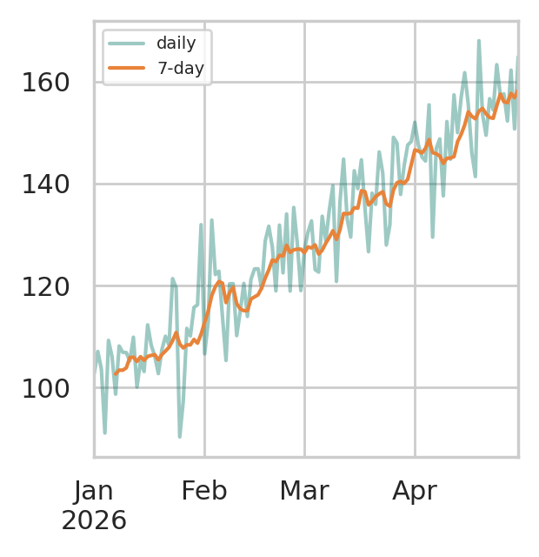
Case: Retail Sales Trend
~4 min
Smooth noisy daily sales (synthetic data).
import numpy as np, pandas as pd
rng = np.random.default_rng(1)
days = pd.date_range("2026-01-01", periods=120)
sales = pd.Series(100 + 0.5 * np.arange(120) +
rng.normal(0, 8, 120), index=days)
ax = sales.plot(alpha=0.4, label="daily")
sales.rolling(7).mean().plot(ax=ax, label="7-day")
ax.legend()
Plot
The question
The method
Is demand really rising, or is daily noise misleading us?
A 7-day rolling mean smooths the noise and shows the trend.

Slide 12
Case: Web Traffic by Hour
~4 min
Find the busiest hour (synthetic data).
import numpy as np, pandas as pd
rng = np.random.default_rng(2)
t = pd.date_range("2026-03-01", periods=72, freq="h")
lam = 20 + 30 * (t.hour == 20)
hits = pd.Series(rng.poisson(lam), index=t)
by_hour = hits.groupby(hits.index.hour).mean()
print(by_hour.idxmax(), round(by_hour.max(), 1))
print(hits.resample("D").sum().tolist())
The question
Which hour is busiest, so servers can be scaled up in time?
Output
The method
20 44.0
[517, 475, 563]
Group by index.hour to average each hour. resample("D") totals each day.

Slide 13
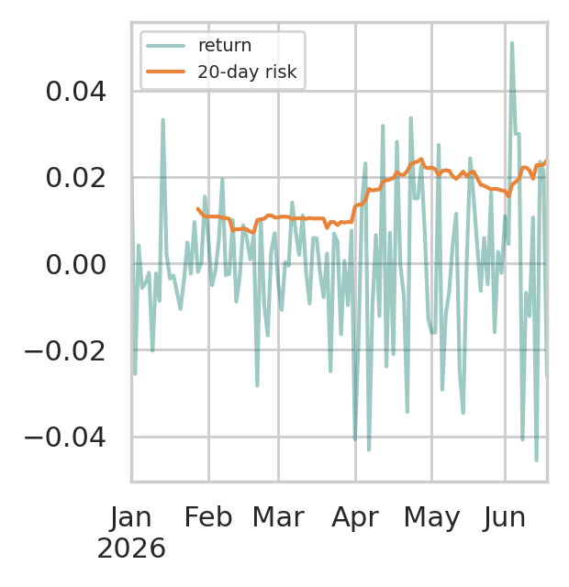
Case: Returns and Risk
~4 min
Watch risk move over time (synthetic data).
import numpy as np, pandas as pd
rng = np.random.default_rng(3)
days = pd.bdate_range("2026-01-01", periods=120)
scale = np.where(days.month > 3, 0.02, 0.01)
ret = pd.Series(rng.normal(0, scale), index=days)
ax = ret.plot(alpha=0.4, label="return")
ret.rolling(20).std().plot(ax=ax, label="20-day risk")
ax.legend()
Plot
The question
The method
Did risk rise this spring? Daily returns look noisy.
rolling(20).std() measures risk over a moving month of trading days.

Slide 14
Time Series Cheat Sheet
~2 min
Match the task to the tool.
Task | Tool
Parse text to dates | pd.to_datetime
Regular dates | pd.date_range(start, periods, freq)
Select by date | ts["2026-02"], ts[a:b]
Change frequency | resample, asfreq
Fill new slots | ffill, interpolate
Compare with the past | shift, diff, pct_change
Moving statistics | rolling(n), expanding()
Time zones | tz_localize, tz_convert
Plot the series before and after every resample to catch surprises.

